Slide 1
How Would You Like To Launch Your Very Own 6-Figure Coaching Business In The Next 34 Days?

Slide 2
What if you could systemise the entire customer acquisition process using a simple automated presentation and a high ticket closer who enrols
$3000 - $10,000 clients daily into your program?

Slide 3

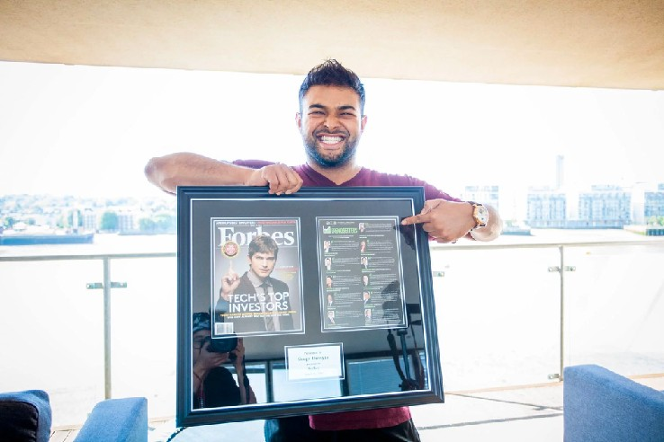
Shaqir Hussyin
CEO Of Funnels.com
30 Years Old - Based In London, UK

Slide 4
How To Swipe & Deploy A Simple 3 Step System Into Your Business That Can Generate Multiple 6-Figures Per Year

Slide 5

Who is this Workshop for?
Coach Consultant Service Provider Author
Speaker
Product Creator
Aspire To Launch A Knowledge Business!

Slide 6
I want to show you how to make more income than ever whilst working less

Slide 7
And the exact strategies I’ve used to scale my business to 8 Figures whilst still having enough free time to enjoy life

Slide 8



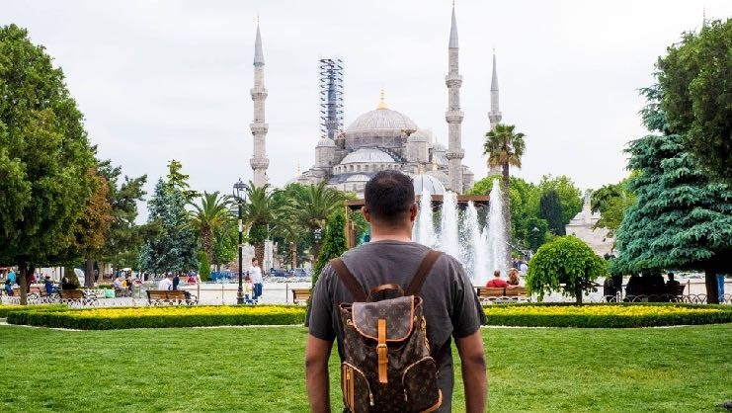
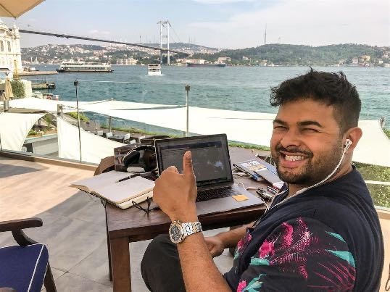




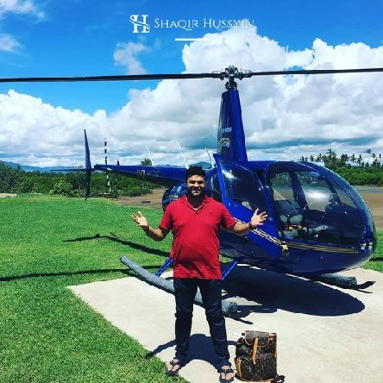

Gives me more time to do what I ❤

Slide 9

4 Common Myths Of Becoming A Coach
I have to do 1-to-1 Consulting
I need to be an experienced teacher
I must learn Phone Sales
I can’t charge High Fee’s

Slide 10
Want to scale FAST?
Leverage Your TIME (Group Coaching) Automate and Systemise EVERYTHING Do NOT do phone sales yourself
Focus on the 80/20 in your business
Charge Higher Fee’s (increases your perceived value) Do this from day one

Slide 11

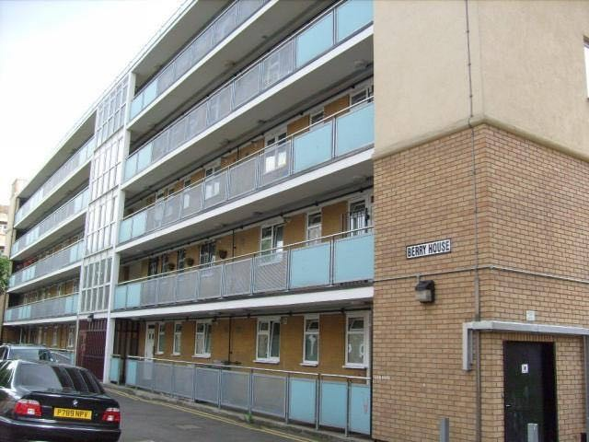
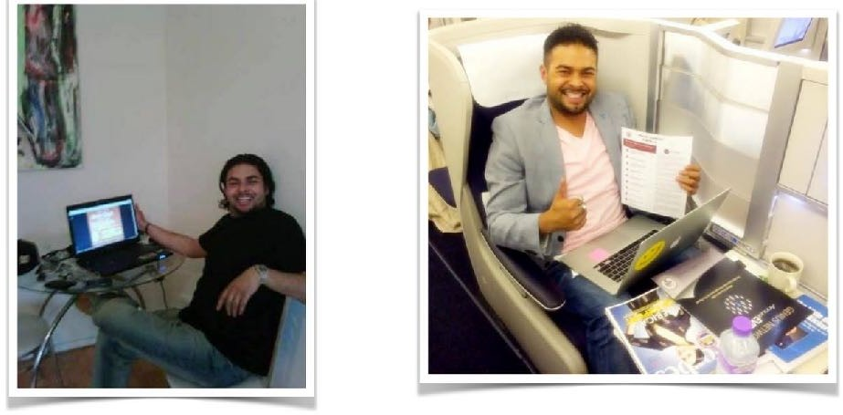
I want to share something with you..
I was programmed to “think small”

Slide 12

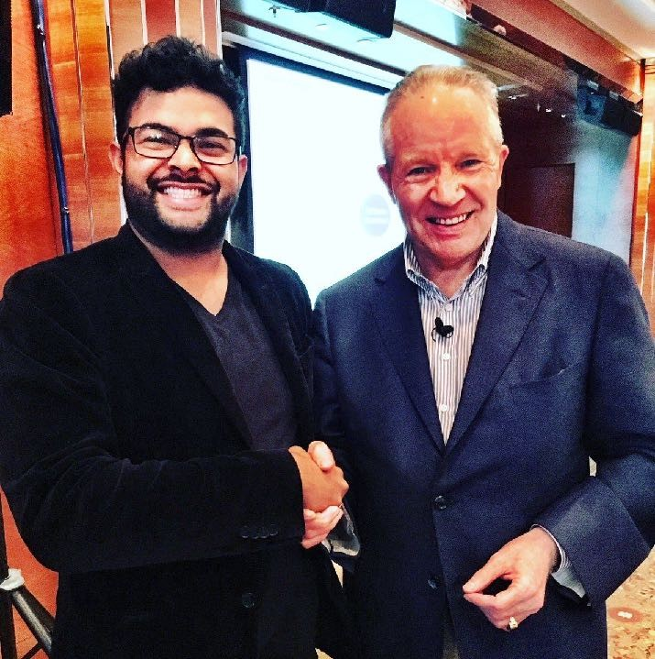
It wasn’t until I found myself a mentor..
EVERYTHING Changed
If you solve DEEP problems you can charge HIGH Fee’s
I finally became comfortable
charging more than $1000
Dan Sullivan
CEO, Strategic Coach

Slide 13

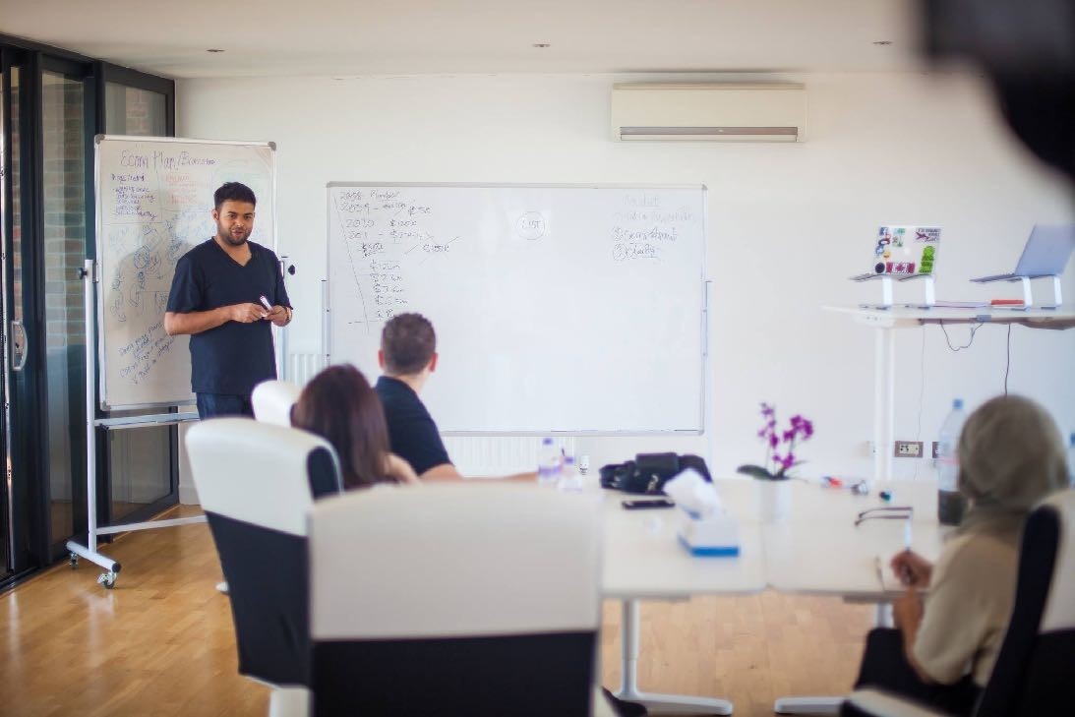
I now charge upwards of $120,000/year

Slide 14
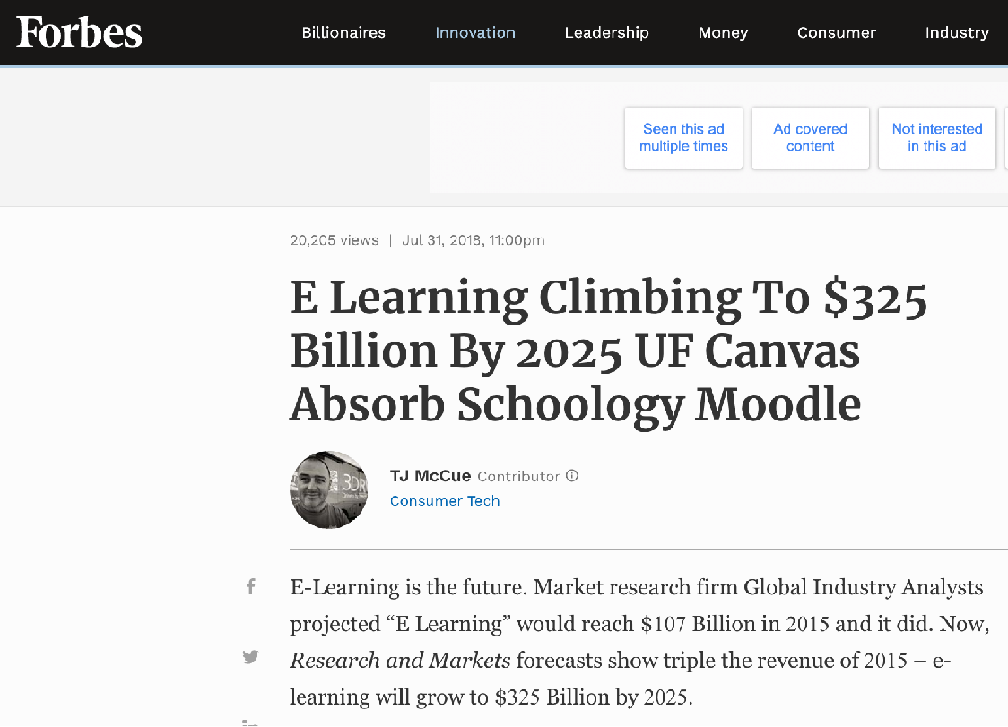
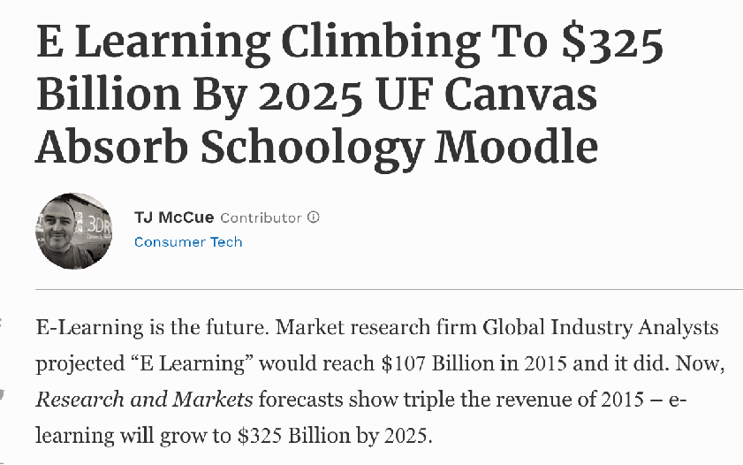
Coaching, Consulting & E-Learning Industry is BOOMING

Slide 15
Using my proven Framework I’ve been able to help several of my students launch 7 Figure and even 8 Figure Businesses

Slide 16
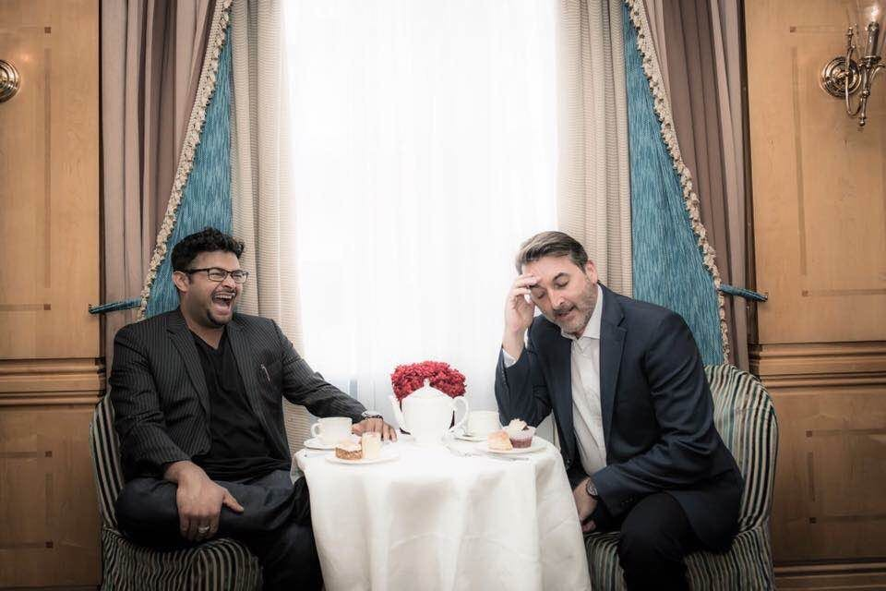
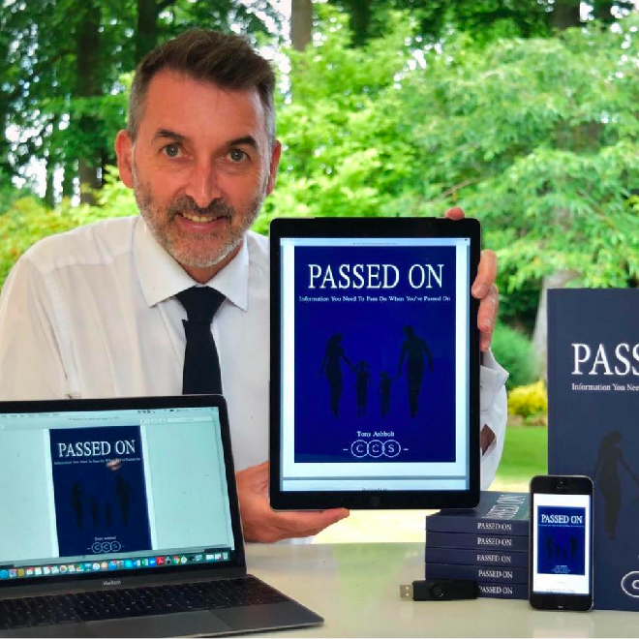
Tony is now Earning $50,000/month by taking His Financial Consultancy Online

Slide 17

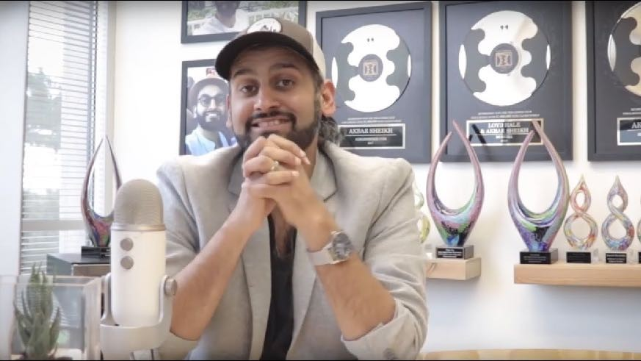
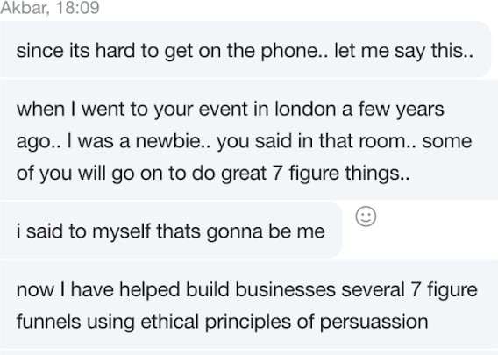
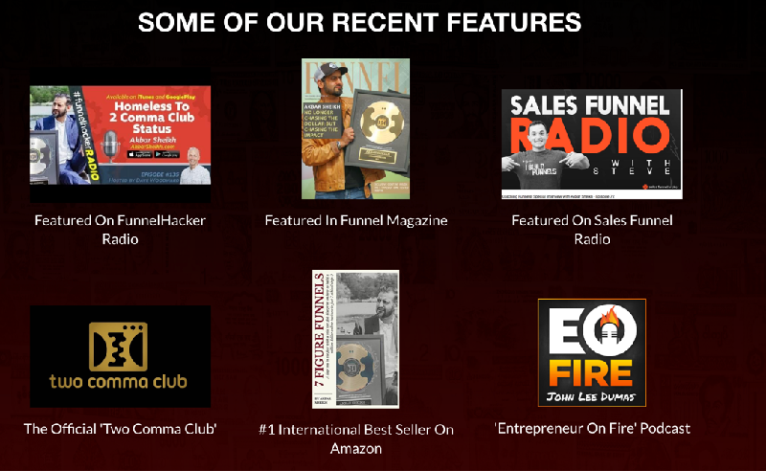

Slide 18
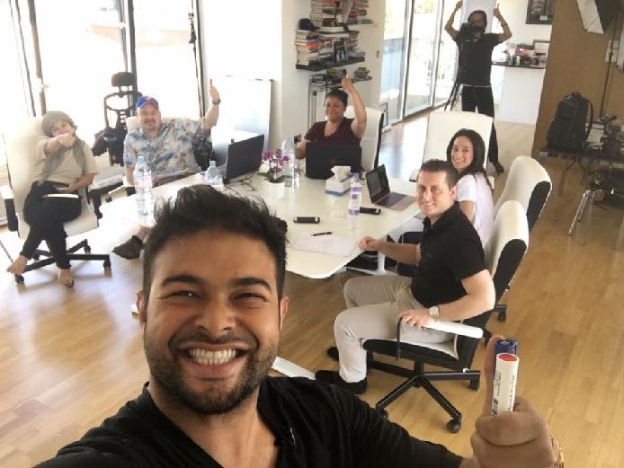

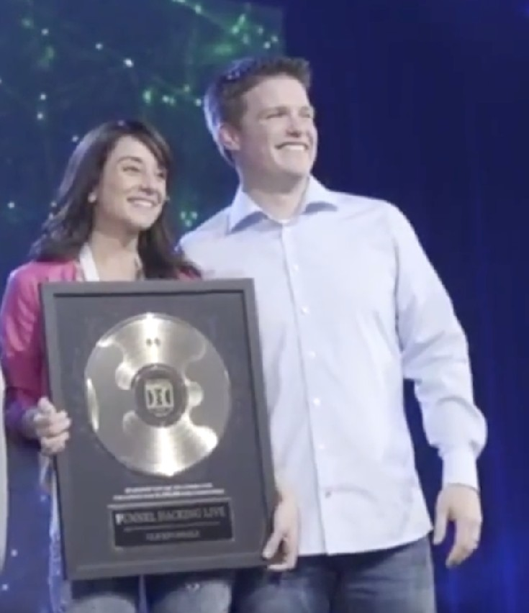

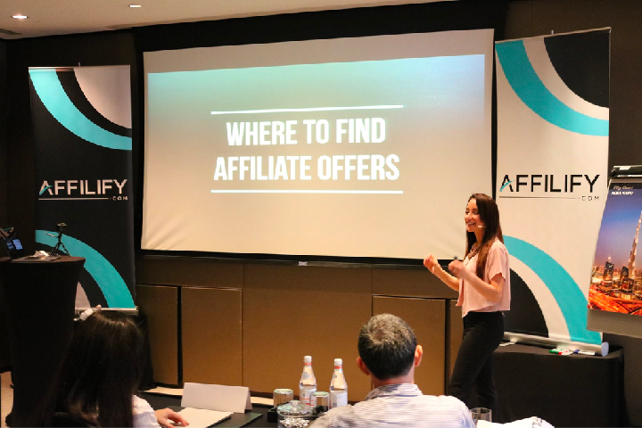
Sylvia hit 7 Figures!

Slide 19

“I Launched My First $3,000 Offer From Scratch And Generated Over
$30,000 In Sales. Now With Shaqir’s Help I’ll Be Creating An Automated Webinar To Create This Every Month Passively”
— Ray Hassan, UK Lifestyle Entrepreneur

Slide 20
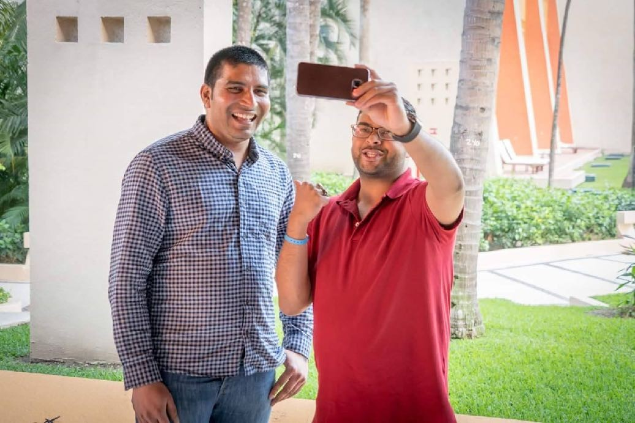
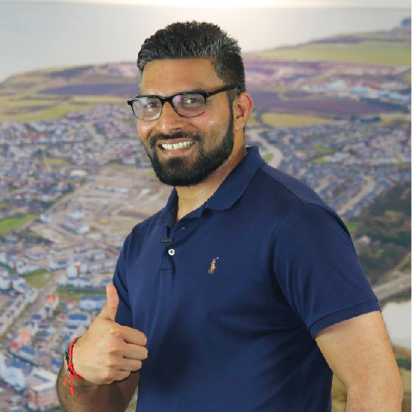
“Launched my first course and made
$200,000 with Shaqir’s Mentoring”
- Venkata Konidala

Slide 21

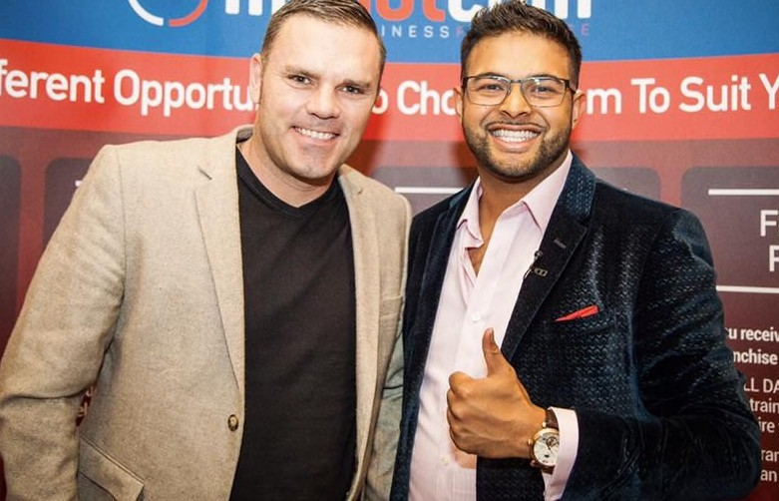
Paul has now made $10MM+

Slide 22
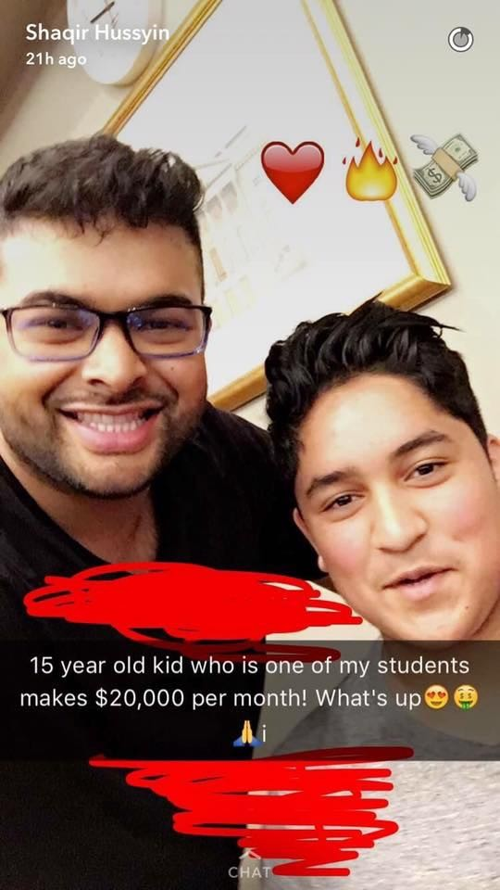
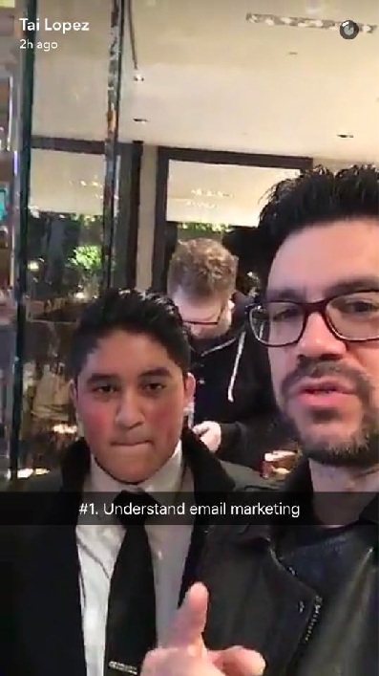


Slide 23
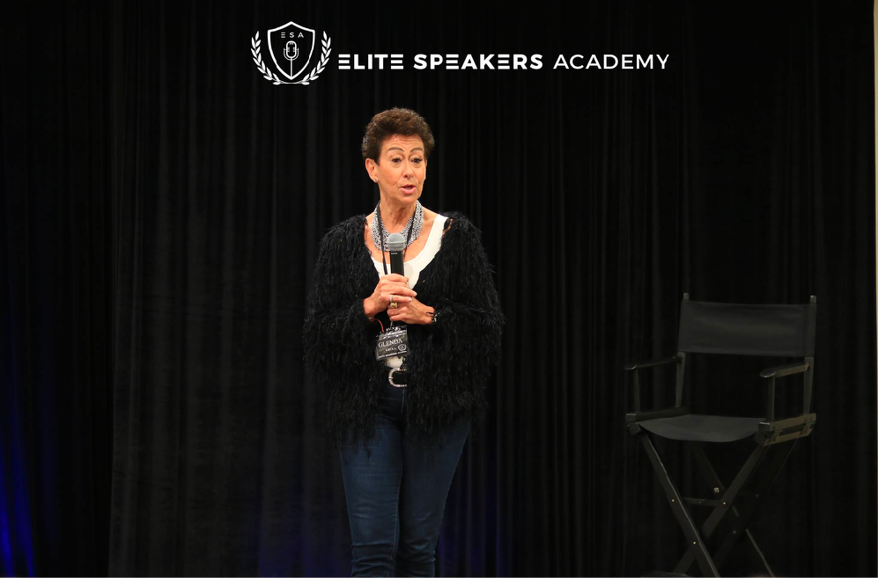
“I got started with Shaqir’s 3-Step funnel to make my first 3 sales online and $12,000…I’m a beginner and this absolutely works!”
- Glenda, Real Estate Developer from Toronto

Slide 24
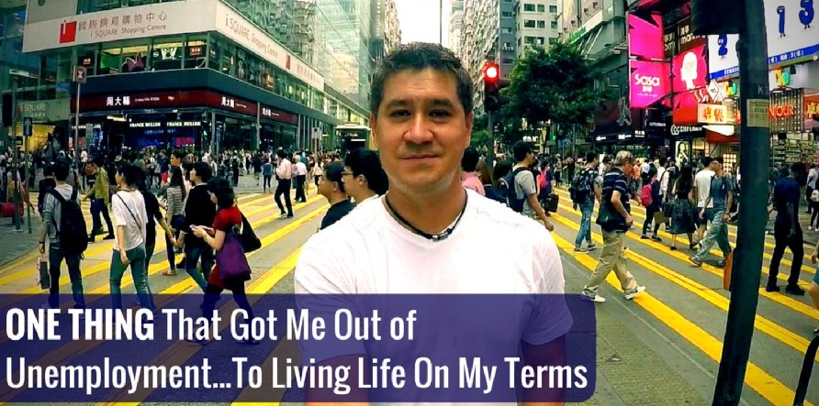
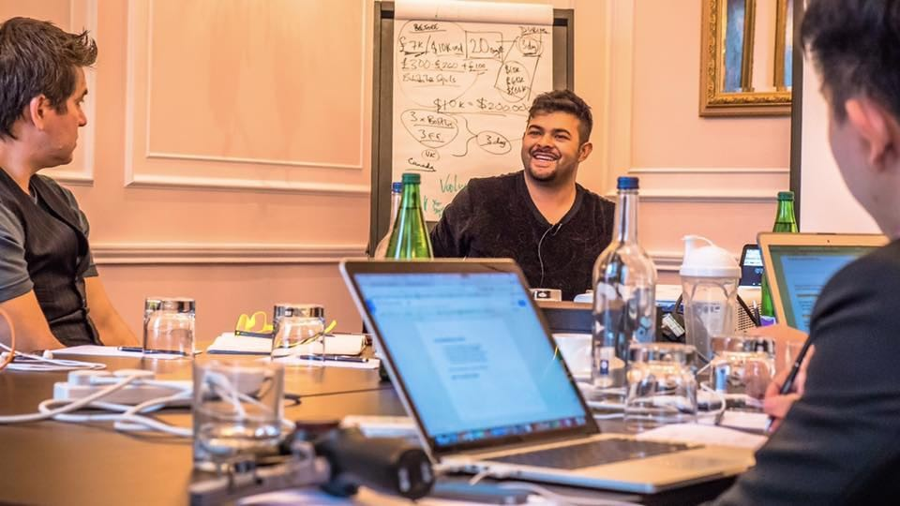
“After 20 Years In Corporate As A Brand Executive, Working For Marlboro Ian Went Onto Make Over $30,000 In A Single Weekend Selling Digital Products...”
- Ian Billingham, Hong Kong

Slide 25
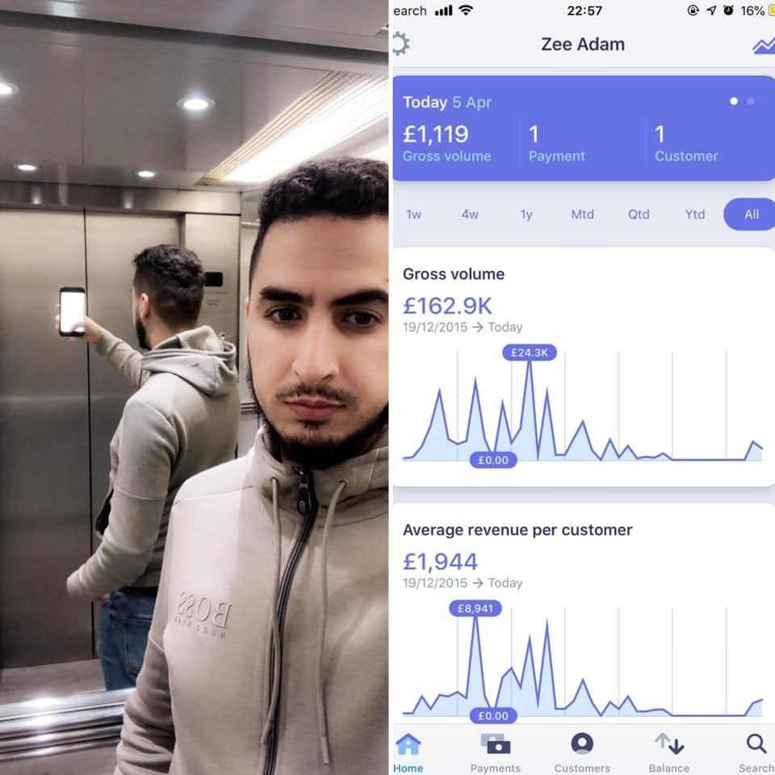
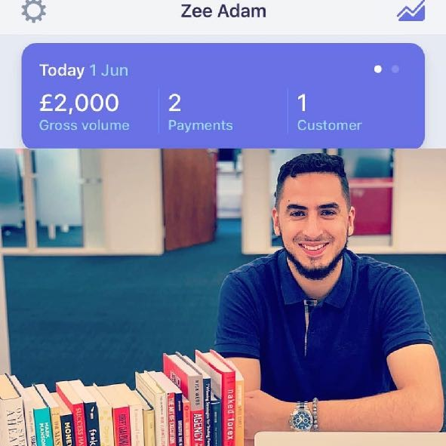

Slide 26
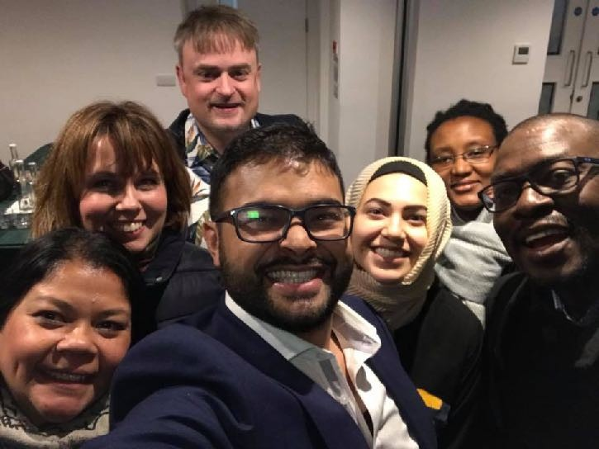
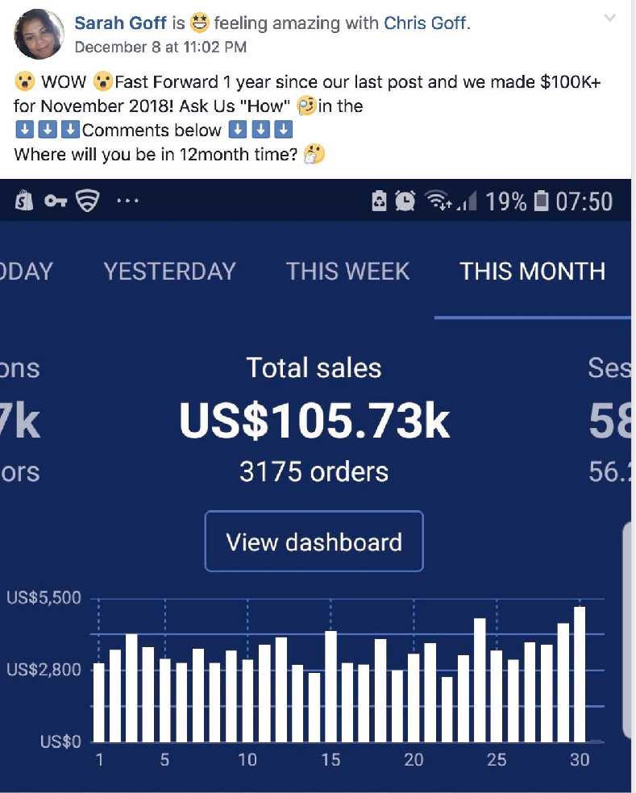

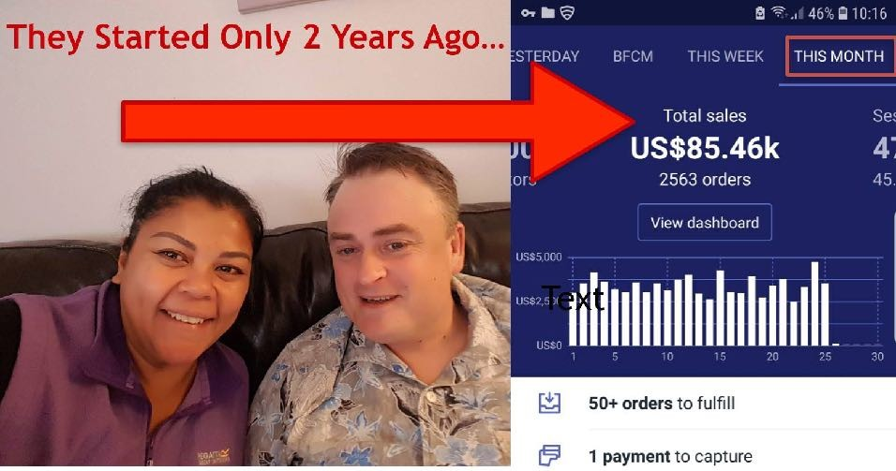


Slide 27
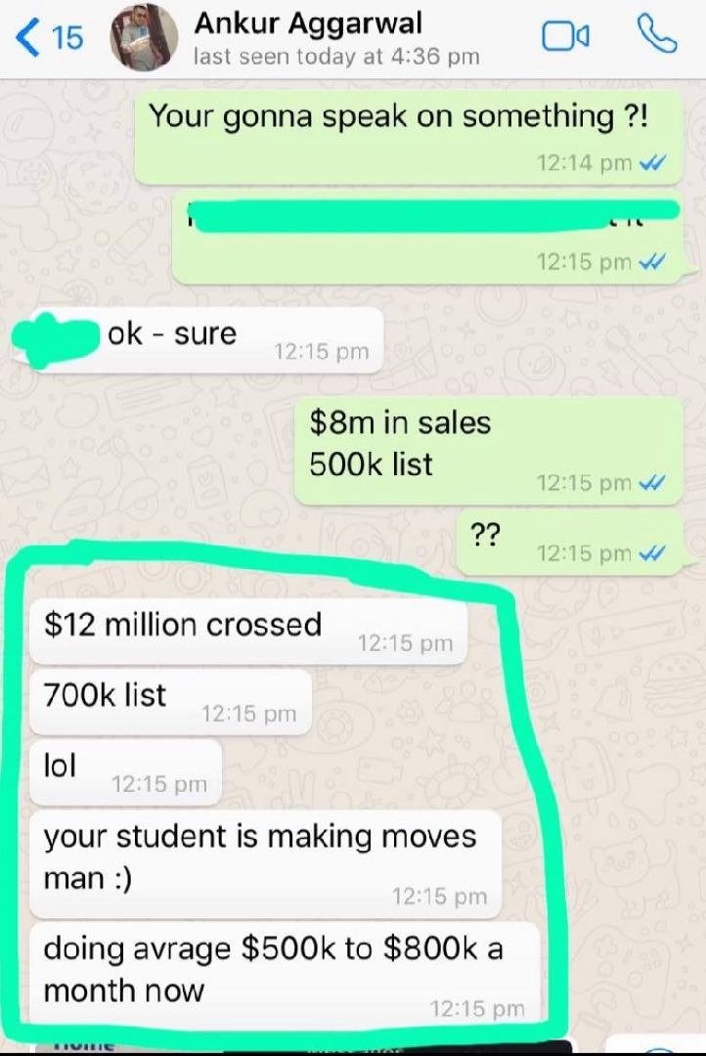
$500K/Month

Slide 28
What would your life look like if..
…you could consistently pull-in upwards of
$20,000,$30,000 or $50,000 a month in income from your expertise or an idea you have for a coaching program or product?

Slide 29
The 3 Step System Responsible For
$20MM In Revenues

Slide 30
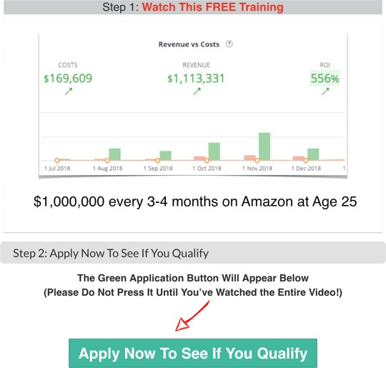
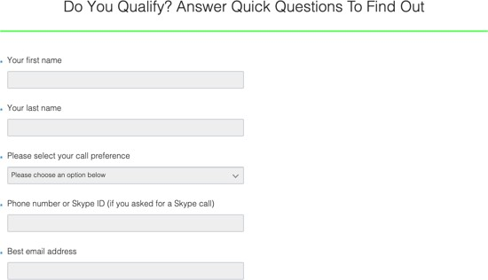



Step 1
Short 20 Minute Video
Step 2
Application
Step 3
Virtual Sales Closer Enrols Client
They Earn 10-15%
only when the $$ hits your bank account

Slide 31
What about leads?
Well, I’ve been using Paid Media to attract
$5,000 to $10,000 clients for the last 4 years..

Slide 32


What about leads?
Facebook
Instagram

Slide 33
Across the 2 Platforms Alone..
Unlimited Potential For SCALE

Slide 34


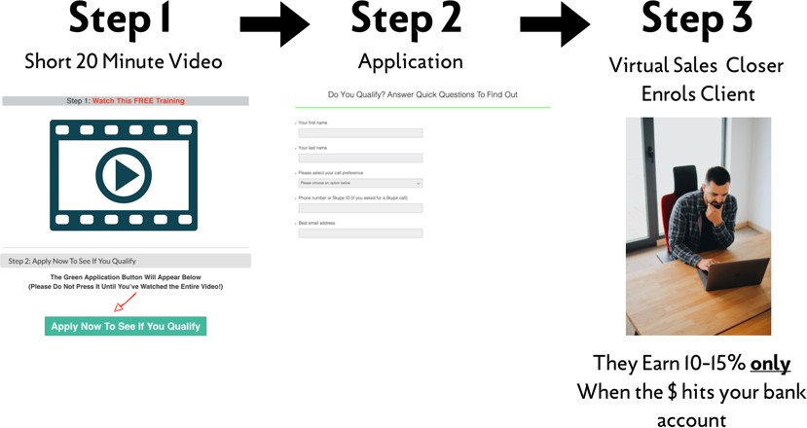

Slide 35
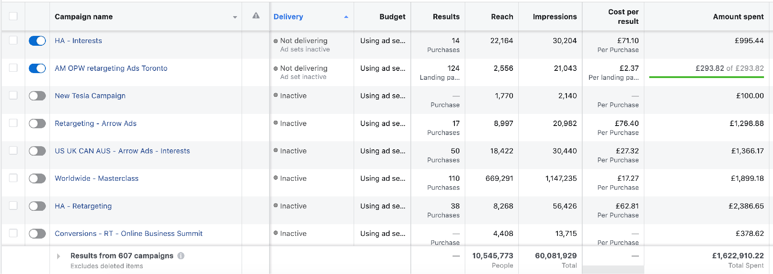


Generate 10X ROI’s
Roughly $2MM to Generate $20MM

Slide 36
So What Do You Need To Get Started
Identify the one DEEP problem you can solve
Structure your Signature Offer ($3k+)
Deploy my Simple 3 Step System
Start Generating High Quality Leads

Slide 37

Here’s what I’d like to do
I’m looking for a few more serious Students to mentor to 7 figures

Slide 38
Here’s how I’d like to help you
Help You Structure your Signature Offer that you can sell for $3000+
Give you my 3 Step Funnel and walk you through step by step how to deploy it your business
Hand over my 8 Figure Frameworks, Systems & processes so you can deploy them in your business from day one INTRODUCE you to 7 Figure Closers so you don’t need to worry about finding ethical, responsible and efficient closers for your Coaching Program

Slide 39
10 New Students ONLY
Taking each of them to 7 Figures..

Slide 40
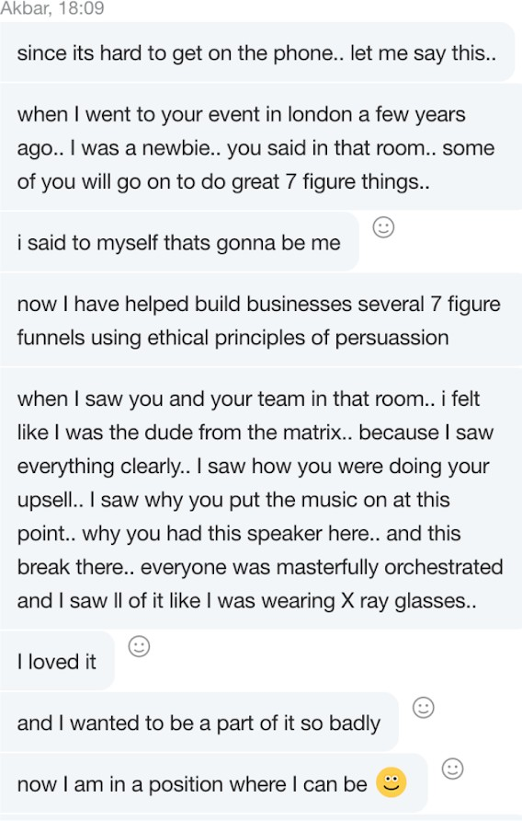
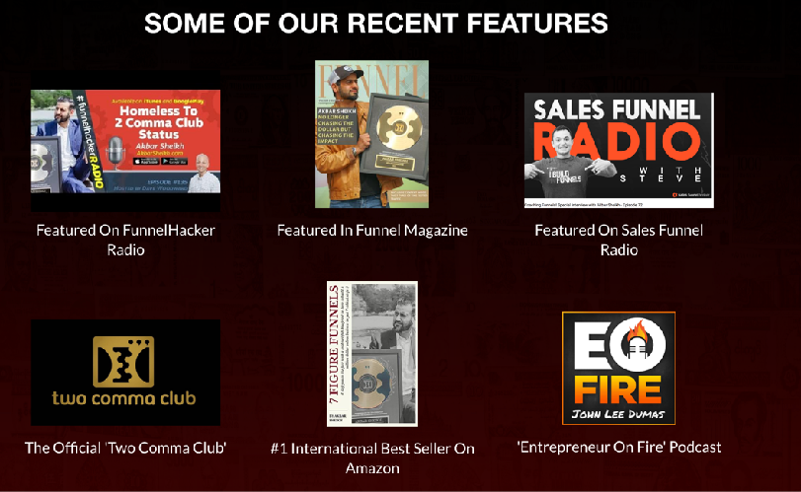

Slide 41

Sylvia

Slide 42

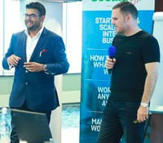
Paul has now made $10MM+

Slide 43


Serious about scaling your business?
Apply below

